Slide 1
NAACC Ethics Update
2015
Bruce A. McCurdy, Ed.D.
George T. Davis, Ph.D. J.D.
April 17, 2015

Slide 2
Background
Ph.D. Clinical Psychology 1984
J.D. Law 1999
Consultant with SSA disability determination since 1986
Consultant with Office of Hearings and Adjudication
(FL, MS, KS, TN)
Adjunct Professor at Vanderbilt/Peabody Human
Development and Counseling Program since 2006
Private Practice in Family Law

Slide 3
Disclaimer
Anything I say may be wrong and immediately refuted by those more knowledgeable
Don’t rely on anything I say

Slide 4
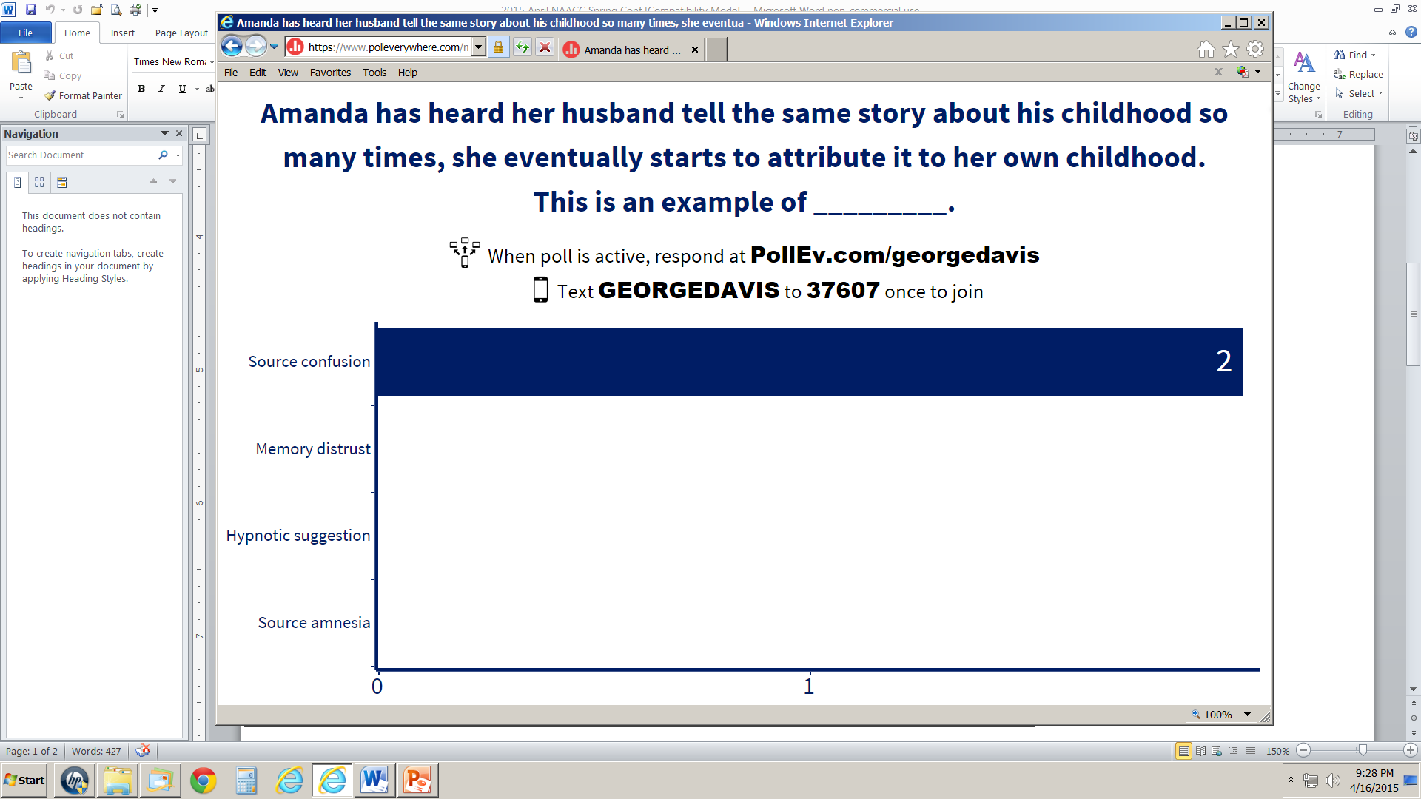
www.TennLegal.com/Downloads

Slide 5
Dilemma One
Limit to Confidentiality
Duty to Warn and Protect

Slide 6
Dilemma One
Limit to Confidentiality
Duty to Warn and Protect
Poll #1

Slide 7
Dilemma One
Limit to Confidentiality
Duty to Warn and Protect
Poll #1
Blunk v Fenton and the University of Colorado

Slide 8
Dilemma One
Limit to Confidentiality
Duty to Warn and Protect
Poll #1
Poll #2

Slide 9
Dilemma One
Limit to Confidentiality
Duty to Warn and Protect
Poll #1
Poll #2
Poll #3

Slide 10
Dilemma One
Limit to Confidentiality
Duty to Warn
Turner v. Jordan (Tenn., 1997)

Slide 11
Turner v. Jordan
Duty to Warn (and Protect)
"the degree of foreseeability needed to establish a duty of care decreases in proportion to the magnitude of the foreseeable harm“ (p. 818)

Slide 12
Turner v. Jordan
Duty to Warn (and Protect)
"the degree of foreseeability needed to establish a duty of care decreases in proportion to the magnitude of the foreseeable harm“ (p. 818)
“The court explained that, depending on the nature of the case, the duty of care may require warning the victim, notifying the police, or whatever other steps are reasonably necessary to protect the third party” (p. 819)

Slide 13
Turner v. Jordan
Duty to Warn (and Protect)
"We reject the notion that the psychiatrist's duty to third persons is limited to those against whom a specific threat has been made…”

Slide 14
Turner v. Jordan
Duty to Warn (and Protect)
"We reject the notion that the psychiatrist's duty to third persons is limited to those against whom a specific threat has been made. . .
the psychiatrist has a duty to exercise reasonable care to protect the foreseeable victim of that danger. The foreseeable victim is one who is said to be within the zone of danger, that is subject to probable risk of the patient's violent conduct” (p. 819)

Slide 15
Assessing Dangerousness
Means/Capacity
Intent

Slide 16
Assessing Dangerousness
A
C
T
I
O
N

Slide 17
Assessing Dangerousness
A- Attitudes that support violence
C
T
I
O
N

Slide 18
Assessing Dangerousness
A- Attitudes that support violence
C- Capacity
T
I
O
N

Slide 19
Assessing Dangerousness
A- Attitudes that support violence
C- Capacity
T-Thresholds crossed
I
O
N

Slide 20
Assessing Dangerousness
A- Attitudes that support violence
C- Capacity
T-Thresholds crossed
I-Intent
O
N

Slide 21
Assessing Dangerousness
A- Attitudes that support violence
C- Capacity
T-Thresholds crossed
I-Intent
O-Other’s reactions/responses
N

Slide 22
Assessing Dangerousness
A- Attitudes that support violence
C- Capacity
T-Thresholds crossed
I-Intent
O-Other’s reactions/responses
N-Noncompliance with risk reduction

Slide 23
Dilemma Two
Record-Keeping
Medical Records v Psychotherapy notes
Retention of Records
Culbertson II
Purging Records
Marital therapy records
Subpoena

Slide 24
Dilemma Two
Record-Keeping
Medical Records v Psychotherapy notes
Retention of Records
Culbertson II
Purging Records
Marital therapy records
Subpoena

Slide 25
Dilemma Two
Record-Keeping
Medical Records v Psychotherapy notes
Retention of Records
Culbertson II
Purging Records
Marital therapy records
Subpoena

Slide 26
Confidentiality: Culbertson II
By declaring oneself to be stable mentally, that does not constitute a general waiver of privilege.
Acknowledging treatment with a specific provider does not constitute a waiver of privilege.
Giving some records to an independent evaluator does not constitute a general waiver.

Slide 27
Confidentiality: Culbertson II
Allowing an independent evaluator to speak with a confidential treating source does not constitute a general waiver.
If evaluating professional asks for access to privileged records, the patient may decline.
Any records given to the independent evaluators are deemed to have been waived of any privilege.

Slide 28
Confidentiality: Culbertson II
Interpretation of TCA 36-6-106(a)(5)
The mental and physical health of the parents or caregivers. The court may, when it deems appropriate, order an examination of a party pursuant to Rule 35 of the Tennessee Rules of Civil Procedure and, if necessary for the conduct of the proceedings, order the disclosure of confidential mental health information of a party pursuant to § 33-3-105(3). The court order required by § 33-3-105(3) shall contain a qualified protective order that, at a minimum, expressly limits the dissemination of confidential protected mental health information for the purpose of the litigation pending before the court and provides for the return or destruction of the confidential protected mental health information at the conclusion of the proceedings . .”

Slide 29
Dilemma Two
Record-Keeping
Medical Records v Psychotherapy notes
Retention of Records
Culbertson II
Purging Records
Marital therapy records
Subpoena

Slide 30
Purging Records
No patient record singled out
Requires established office operating procedures
Burn or shred
Date, time and method of destruction recorded for reference

Slide 31
Purging Records
SAMPLE OFFICE OPERATING PROCEDURES

Slide 32
Dilemma Two
Record-Keeping
Medical Records v Psychotherapy notes
Retention of Records
Culbertson II
Purging Records
Marital therapy records
Subpoena

Slide 33
Dilemma Two
Record-Keeping
Medical Records v Psychotherapy notes
Retention of Records
Culbertson II
Purging Records
Marital therapy records
Subpoena

Slide 37
Fact Witness
1. No or minimal pay
2. Testify only what you saw, heard or observed directly; not expected to prepare
3. State diagnosis given and criteria you observed
4. No testimony/opinion regarding what damages are typical
5. No testimony/opinion regarding typical course of treatment or outcome
6. No testimony/opinion regarding causation

Slide 38
Expert Witness
1. Paid for preparing and testifying
2. Paid in advance
3. Testify as to causation, outcome, future needs, typical treatment

Slide 39
Dilemma Three
Managing Values
Ward v Polite
Keeton v Anderson-Wiley
RFRA (Religious Freedom Restoration Act)
Four-Layered Ethics

Slide 40
Dilemma Three
Religious Freedom Restoration Act
Wildflower Inn in Vermont told a lesbian couple in 2010 that the inn didn't host "gay receptions" because of the owners' "personal feelings." In August, 2012 the Inn settled the lawsuit, it agreed to pay a $10,000 civil penalty, to place $20,000 in a charitable trust and to stop hosting weddings -- whether the couple is gay or straight.
In New Jersey, the Methodist Ocean Grove Camp Meeting Association refused to allow a lesbian couple to hold a ceremony at its boardwalk pavilion in 2007. The New Jersey Division on Civil Rights ruled in 2012 that the association, which gets a tax exemption, must cease and desist violating the law but did not impose a fine or other penalty. The association stopped renting out the pavilion for marriages.

Slide 41
Dilemma Three
Religious Freedom Restoration Act
In August 2014 the owners of Liberty Ridge Farm were fined $13,000 and told they could not discriminate against same-sex couples after refusing to allow a gay wedding on their New York farm have announced that they will “no longer host any wedding ceremonies on their property.”
The Colorado Civil Rights Commission ruled in May 2014 that Jack Phillips and his staff at Masterpiece Cakeshop must create cakes for same-sex celebrations and comply with Colorado’s Anti-Discrimination Act.

Slide 42
Dilemma Three
Religious Freedom Restoration Act
Don’t refuse to see gay couples because they are gay.
Refer based on lack of experience and desire to do no harm. . . Not because you refuse to provide services

Slide 43
Dilemma Four
Fraudulent Marketing
Polls

